Slide 1



AES
By, Rahul Kumar

Slide 2
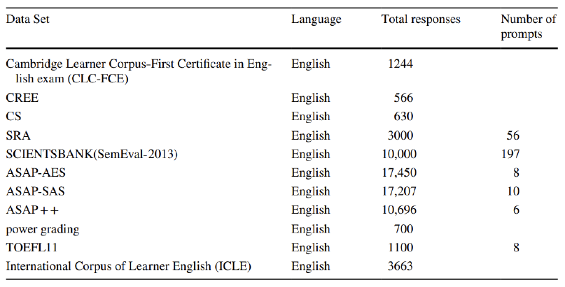
Datasets available for research on AES
It also provides a number of essays and corresponding prompts.

Slide 3
Features
In neural networks and other supervised machine learning techniques, features are crucial. The automatic essay grading systems assign grades to student essays in accordance with a variety of factors, which are crucial for modelling training. They are divided into three groups according to their syntax and semantics:
Statistical based Features
Style-based Features
Content-based Features

Slide 4
Vectorization
The term "vectorization" refers to a traditional method of transforming input data from its raw format (i.e., text) into vectors of real numbers, which is the format that is supported by ML models.
In Machine Learning, vectorization is a step in feature extraction. By transforming textual data into numerical vectors, the goal is to extract some distinctive features from the text for the model to train on.
It can speed up code execution and shorten the training time required for code.

Slide 5
Vectorization Techniques
Bag of Words
TF-IDF
Word2Vec
Glove
Fast Text

Slide 6

Bag of Words
Bag-Of-Words is an algorithm that transforms variable-length texts into fixed-length vectors.
In Machine Learning, by using the bag-of-words (BoW) technique, we convert a text into its equivalent vector of numbers.
In this approach, features are unique words and feature values are word counts.

Slide 7
BOW involves three operations
1. Tokenization
First, the input text is tokenized into a list of tokens (words).
2. Vocabulary creation
Only unique tokens are selected from the obtained token list to construct the vocabulary of words, which is then arranged alphabetically.
3. Vector creation
Lastly, using the frequency of vocabulary words, a sparse matrix is created for the input where each row represents a sentence vector whose length (the matrix's columns) is equal to the size of the vocabulary.

Slide 8
CountVectorizer()
Python’s scikit-learn has a class named ‘CountVectorizer’ that provides a simple implementation for performing vectorization on text data.
Important parameters of CountVectorizer:
lowercase : convert all characters to lowercase.
stop_words : remove stopwords from the text before vectorization. {english},list, default=None. If ‘english’, a built-in stop word list is used.
strip_accents : {‘ascii’, ‘unicode’}, default=None, Remove accents and perform other character normalization during the preprocessing step.
ngram_range : tuple (min_n, max_n), default=(1, 1), range of n-values for different word n-grams to be extracted.

Slide 9
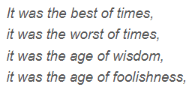
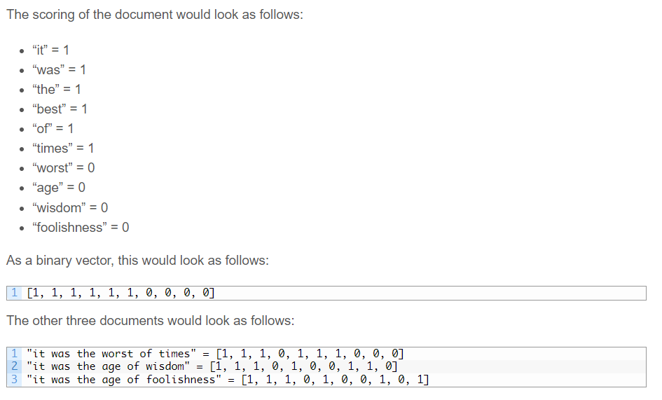
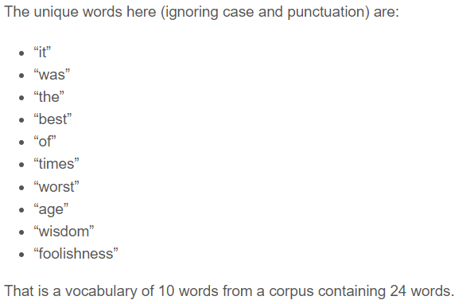

Slide 10
TF-IDF (or Term Frequency - Inverse Document Frequency) is a statistical measure that indicates how relevant a word is to a document.
Bag-of-words has higher perplexity (it is less predictive of natural language) than other models as the order and the meaning of the words are lost using this method. This is why different methods, such TF-IDF, are preferred for extracting features from the text.
It has two parts: TF (Term Frequency) and IDF (Inverse Document Frequency)
TF-IDF

Slide 11
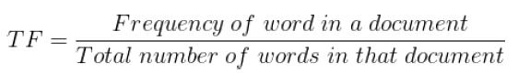
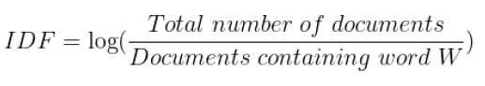
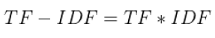
The Term Frequency (TF) is the frequency of a word in a document. It can be understood as a normalized frequency score.
The Inverse Document Frequency (IDF) is a measure of how much information a word provides. It is calculated by taking the inverse log of document frequency, that is the proportion of documents that contain a particular word.
TF-IDF scores range from 0 to 1. A score closer to 1 is higher the importance of a word to a document.
The final TF-IDF score comes out to be:

Slide 12
Word2Vec
Word2Vec is a word embedding technique that utilizes neural networks to translate words into equivalent vectors in such a way that vectors that are semantically similar are close to one another in N-dimensional space, where N is the vector's dimensions.
We observed how semantics were completely disregarded in both TF-IDF and Bag of Words, where each word was treated as a distinct entity. Word2Vec was touted as being the first time ever that the vector representation of words was contextually aware.

Slide 13
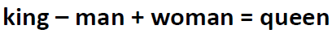
Word2Vec has the ability to preserve semantic relationships between words.
One of the most famous examples of Word2Vec is the following expression:
It can be understood by a simple example where if we have a “king” vector and we remove the vector “man” from the king and add a “women” vector, then we get a vector close to the “queen” vector in N-dimensional space.
There are two ways to implement Word2Vec techniques: Skip-Gram and CBOW

Slide 14
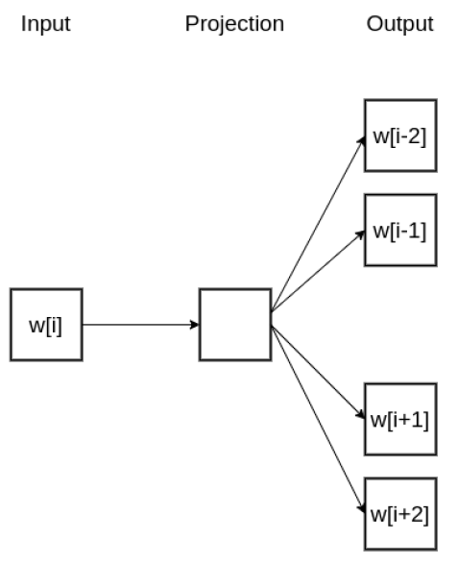
Skip-Gram tries to predict several context words from a single input word.
In this architecture, it takes the current word as an input (w[i]) and tries to accurately predict the words before and after this current word with respect to location ‘I’. This model essentially tries to learn and predict the context words around the specified input word.

Slide 15
Continuous Bag of Words, or CBOW where we input the context words into the model and ask the network to predict the current word rather than predicting the context words.
It is basically trained to predict a single word from a series of context words. It is the mirror image of the Skip-Gram technique.
Skip-Gram works well with small-size datasets and can find rare words as well. However, CBOW trains faster and can better represent frequent words.

Slide 16
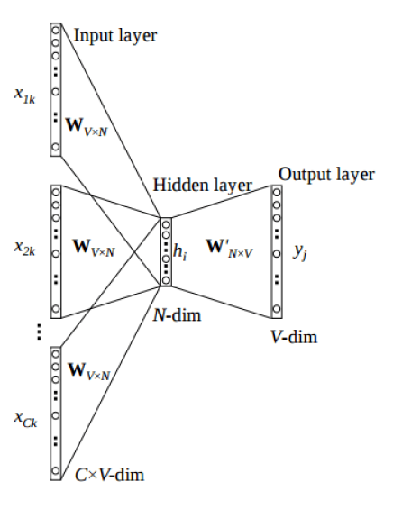
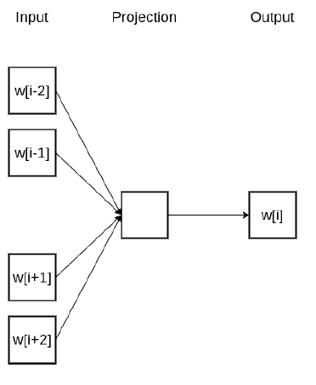

Slide 17
Evaluation Metrics
The majority of the AES systems are using three evaluation metrics:
Quadrated weighted kappa (QWK)
Mean Absolute Error (MAE)
Pearson Correlation Coefficient (PCC)

Slide 18
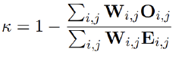
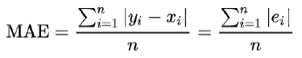
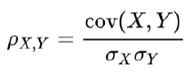
Quadrated weighted kappa (QWK)
The quadratic weighted kappa will find agreement between human evaluation score and system evaluation score and produces value ranging from 0 to 1.
Mean Absolute Error (MAE)
The Mean Absolute Error is the actual difference between human rated score to system generated score. The mean square error (MSE) measures.
Pearson Correlation Coefficient (PCC)
It finds the correlation coefficient between two variables. It will provide three values (0, 1, −1). "0" represents human rated and system scores that are not related. "1" represents an increase in the two scores. "−1" illustrates a negative relationship between the two scores.

Slide 19
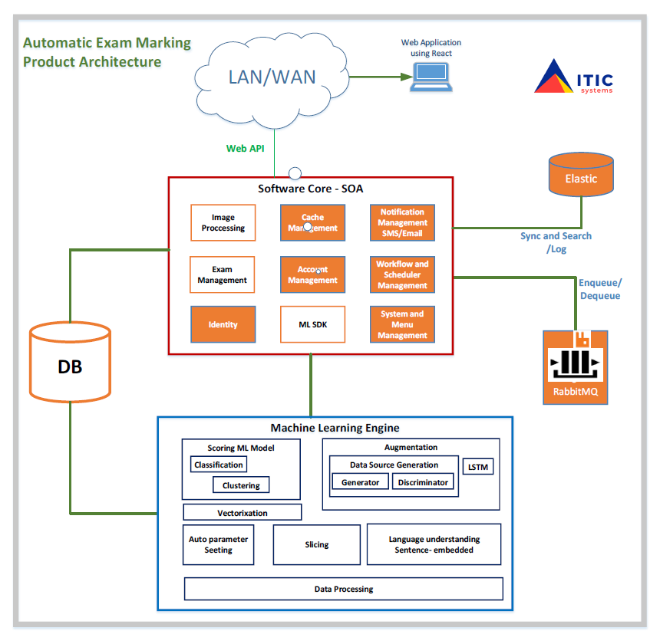
Product Architecture

Slide 20
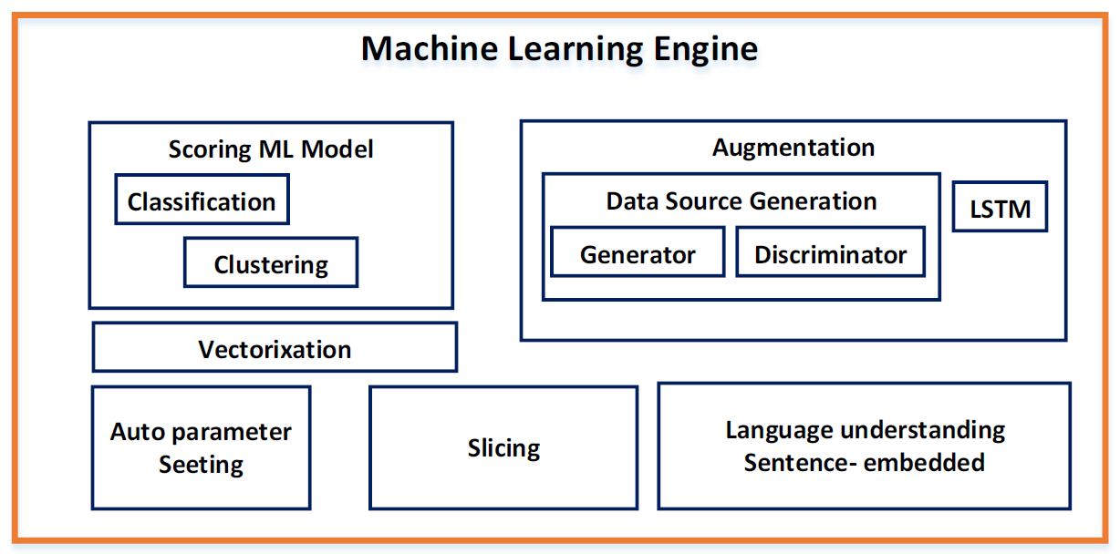
Sample Component of ML Engine

Slide 21
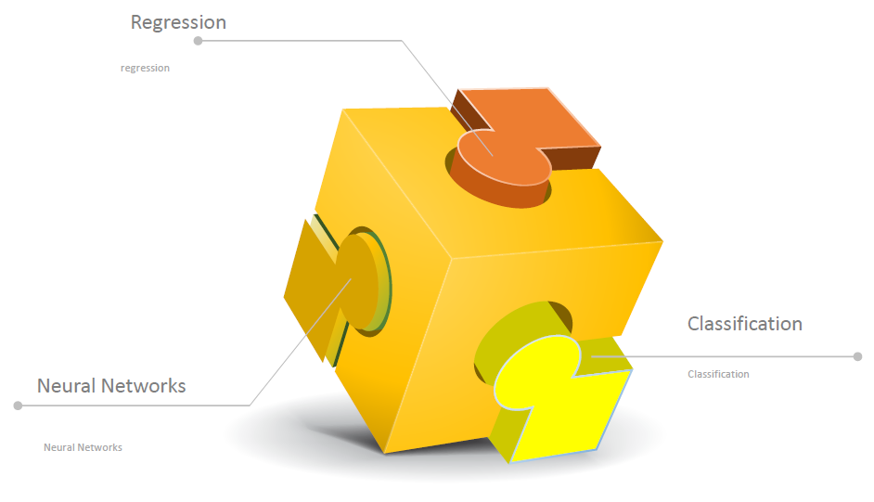
Machine Learning Techniques

Slide 22
Challenges in automated essay grading systems
One should assess the essay by following parameters like:
The relevance of the content to the prompt
Development of ideas
Cohesion: There is no discussion about the cohesion of the essays
Coherence: There is no discussion about the coherence of the essays
Domain knowledge: All researches concentrated on extracting the Features using some NLP libraries, trained their models, and testing the results.

Slide 23
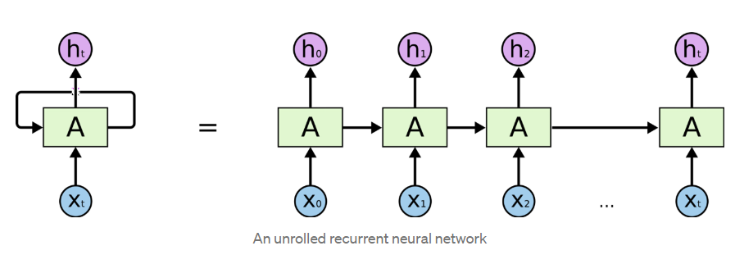
Recurrent Neural Networks (RNN)
RNNs are feed-forward neural networks that are rolled out over time. A RNN can be thought of as multiple copies of the same network, each network passing a message to a successor.

Slide 24
An RNN has two major disadvantages
Slow to train
Vanishing gradient

Slide 25

Long Short-Term Memory (LSTM)
Long short-term memory (LSTM) is a special kind of RNN, specially made for solving vanishing gradient problems. They are capable of learning long-term dependencies.
LSTMs can selectively remember or forget things that are important and not so important.

Slide 26
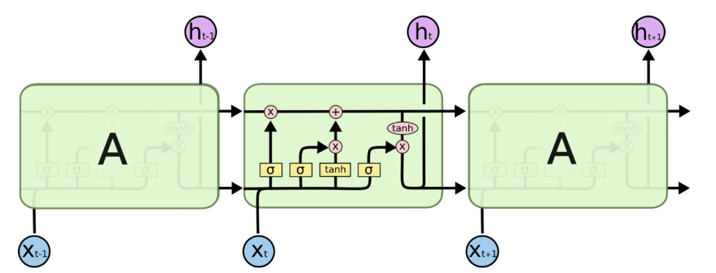
LSTM is even more slower to train as compared to RNN.
Vanishing gradient problem still persists.
Sequential computation inhibits parallelization.
Distance between positions is linear
Drawbacks of LSTM

Slide 27
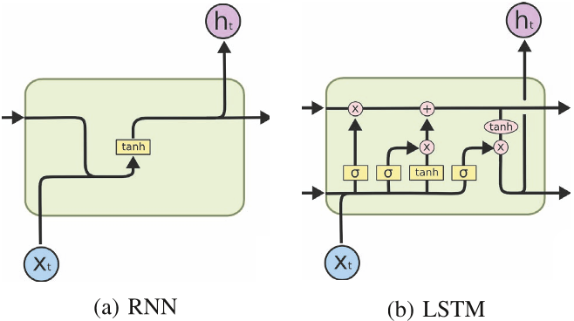
Simple RNN vs LSTM

Slide 28

THANK YOU

